Slide 1

6th Grade Accelerated Math
Unit 13, Lesson 5 Writing Algebraic Expressions Volume 2, pg. 284

Slide 2


Benchmark
MA.6.AR.1.1
Given a mathematical or real-world context, translate written descriptions into algebraic expressions and translate algebraic expressions into written descriptions.
volume 2, pg. 284

Slide 3
Integrated Mathematical Thinking and Reasoning Standards
MA.K12.MTR.1.1 Actively participate in effortful learning both individually and collectively.
MA.K12.MTR.2.1 Demonstrate understanding by representing problems in multiple ways.
MA.K12.MTR.4.1 Engage in discussions that reflect on the mathematical thinking of self and others.
MA.K12.MTR.5.1 Use patterns and structure to help understand and connect mathematical concepts.
MA.K12.MTR.7.1 Apply mathematics to real-world contexts.
volume 2, pg. 284

Slide 4

Learning Targets
I can translate a written description into an algebraic expression.
I can translate a real-world description into an algebraic expression.
volume 2, pg. 284

Slide 5

Warm-Up
volume 2, pg. 285

Slide 6
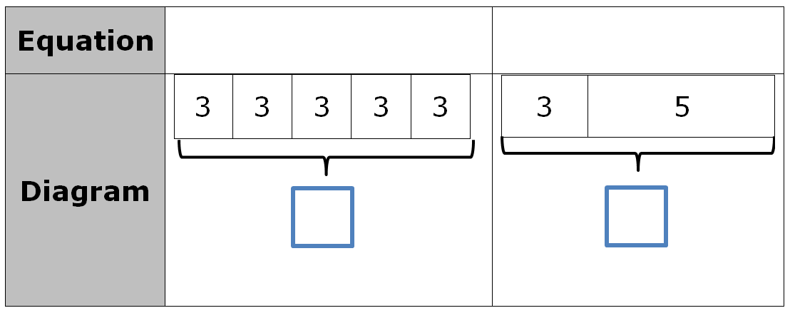
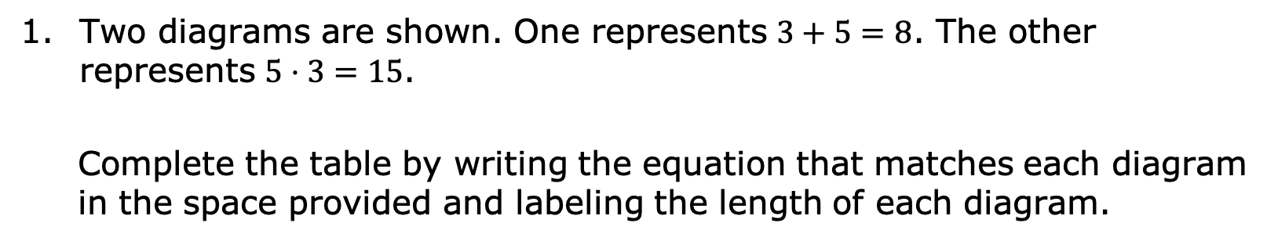
13.5.1 Warm-Up: Bell Work
Two diagrams are shown. One represents $3+5=8$. The other represents $5⋅3=15$.
Complete the table by writing the equation that matches each diagram in the space provided and labeling the length of each diagram.
volume 2, pg. 285

Slide 7

Draw a diagram that represents each equation.
a. $4+3=7$
b. $4⋅3=12$
volume 2, pg. 285

Slide 8

Guided Instruction
volume 2, pg. 285

Slide 9
13.5.2 Guided Instruction: Making Sense with Models
An algebraic expression is a mathematical statement containing numbers, operators, and at least one unknown, represented by a variable.
Complete the statement. An expression have an equal sign or inequality symbol. Bar models help connect the action of a problem to an algebraic expression.
does
does not
volume 2, pg. 285

Slide 10
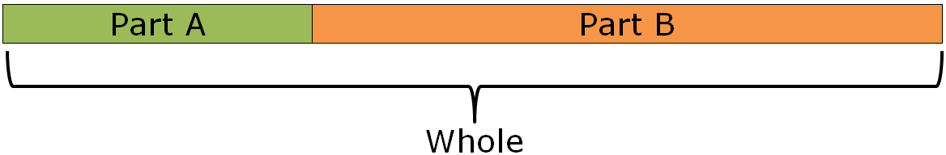
Part-Part-Whole Model
The part-part-whole model can be used to show the following actions.
Action | Equation
Combining or joining | Part A + Part B = Whole
Taking away or separating | Whole – Part A = Part B Whole – Part B = Part A
volume 2, pg. 285

Slide 11
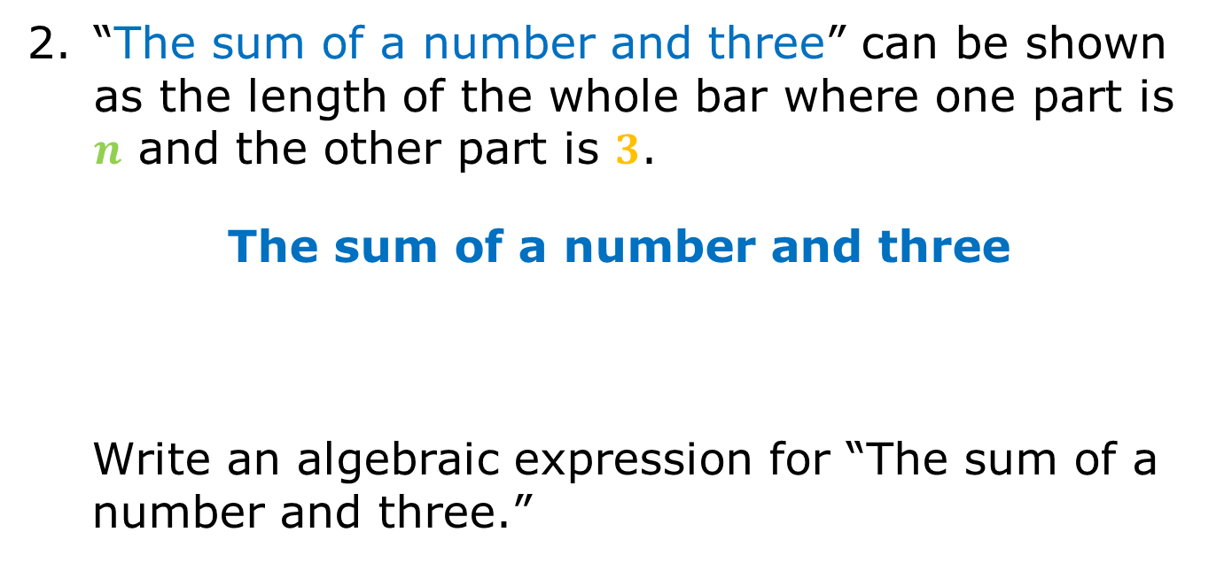
“The sum of a number and three” can be shown as the length of the whole bar where one part is $n$ and the other part is $3$.
The sum of a number and three
Write an algebraic expression for “The sum of a number and three.”
volume 2, pg. 286

Slide 12
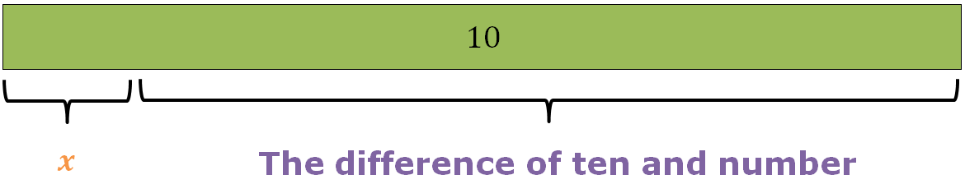

“The difference of ten and a number” can be shown where the whole bar is $10$ and one part is a number represented by a variable, $x$. The difference is the other part.
Write an algebraic expression for “The difference of ten and a number.”
volume 2, pg. 286

Slide 13
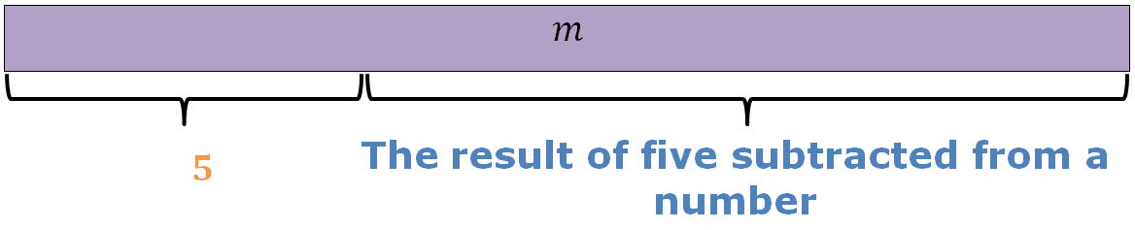
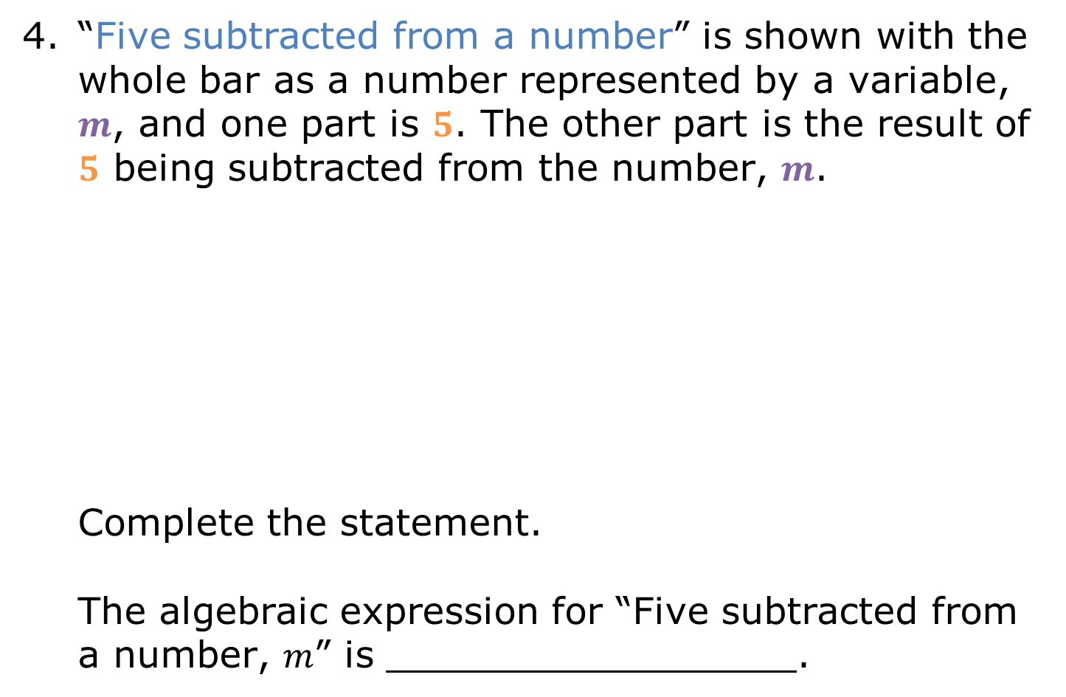
“Five subtracted from a number” is shown with the whole bar as a number represented by a variable, $m$, and one part is $5$. The other part is the result of $5$ being subtracted from the number, $m$. Complete the statement. The algebraic expression for “Five subtracted from a number, $m$” is .
volume 2, pg. 286

Slide 14
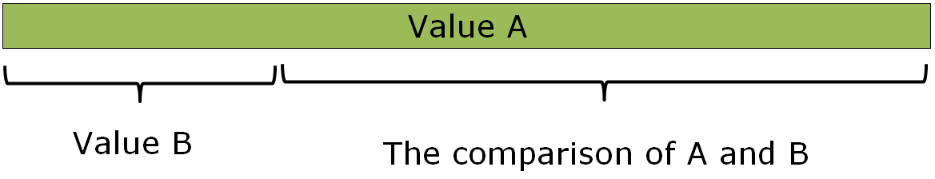
Addition/Subtraction Comparison Model
Comparison models are much like part-part-whole models. They show how much more or less one value is than another.
How much more Value A is than Value B, or
How much less Value B is than Value A
volume 2, pg. 286

Slide 15
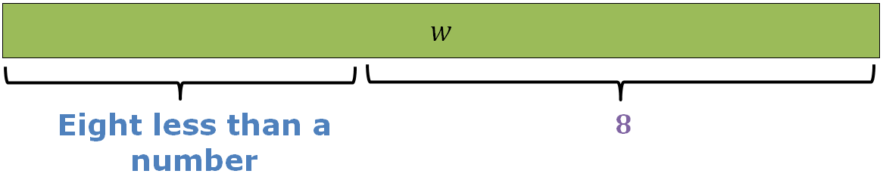
Write an algebraic expression for the bar model shown.
Algebraic expression:
volume 2, pg. 287

Slide 16
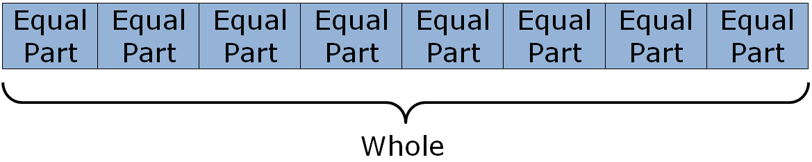
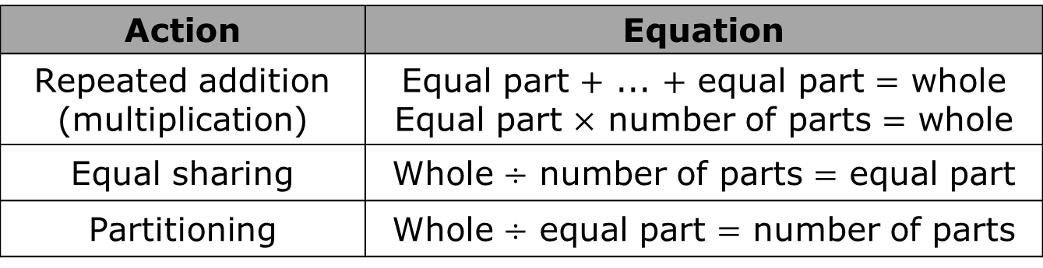
Equal Parts – Whole Model
The Equal Parts – Whole Model shows the whole sectioned into equal parts.
The equal parts-whole model can be used to show the following actions.
Action | Equation
Repeated addition (multiplication) | Equal part $+$ ... $+$ equal part $=$ whole Equal part $×$ number of parts $=$ whole
Equal sharing | Whole $÷$ number of parts $=$ equal part
Partitioning | Whole $÷$ equal part $=$ number of parts
volume 2, pg. 287

Slide 17
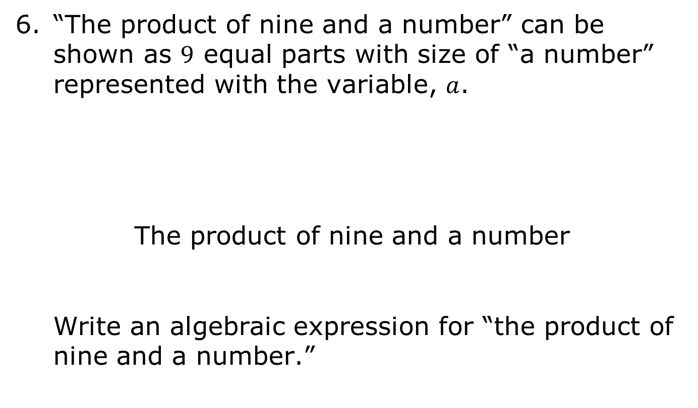
“The product of nine and a number” can be shown as $9$ equal parts with size of “a number” represented with the variable, $a$.
The product of nine and a number
Write an algebraic expression for “the product of nine and a number.”
volume 2, pg. 287

Slide 18
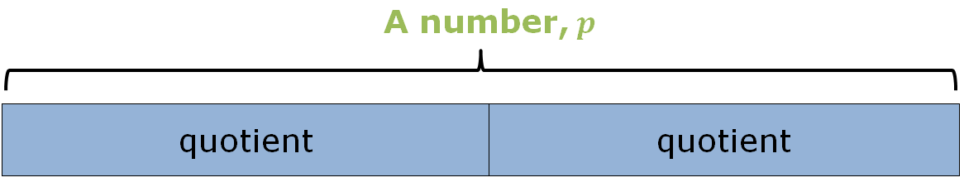
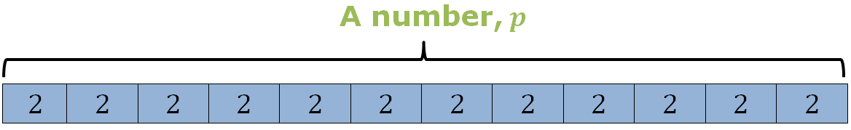
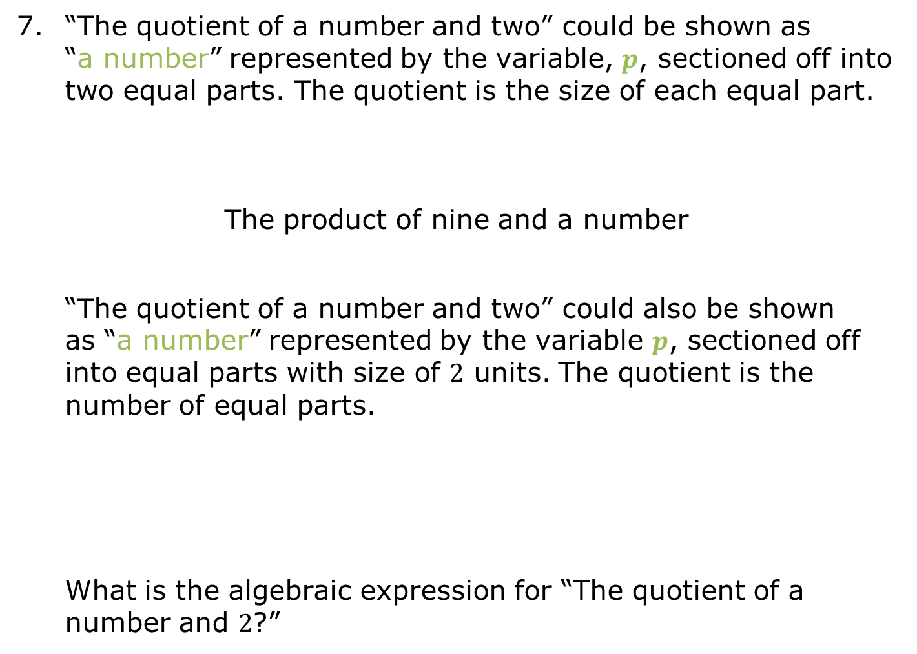
“The quotient of a number and two” could be shown as “a number” represented by the variable, $p$, sectioned off into two equal parts. The quotient is the size of each equal part.
The product of nine and a number
“The quotient of a number and two” could also be shown as “a number” represented by the variable $p$, sectioned off into equal parts with size of $2$ units. The quotient is the number of equal parts.
What is the algebraic expression for “The quotient of a number and $2$?”
volume 2, pg. 287

Slide 19

Collaboration
volume 2, pg. 288

Slide 20

13.5.3 Collaboration: Matching Activity
Part 1
Match each written description to the appropriate bar model, where the red portion is the result of the written description. Write the letter of the bar model beside the corresponding word description.
volume 2, pg. 288

Slide 21
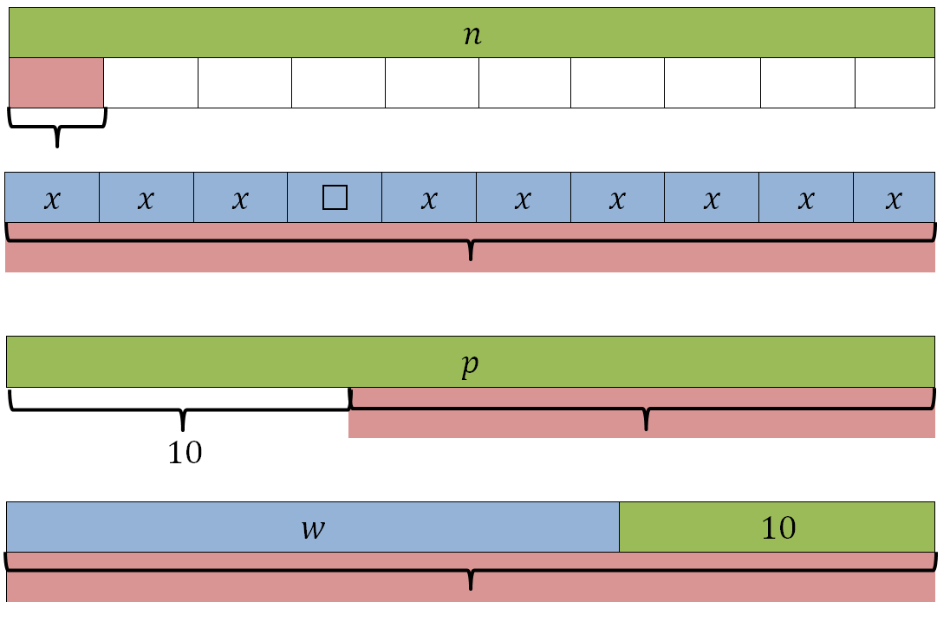
Written Description | Bar Model
Ten subtracted from a number
A number divided by ten
The sum of a number and ten
A number times ten
volume 2, pg. 288

Slide 22
Part 2
Turn and talk with your partner to compare your matches. Then, work with your partner to write an algebraic expression that represents the written description and bar model.
Written Description | Algebraic Expression
Ten subtracted from a number
A number divided by ten
The sum of a number and ten
A number times ten
volume 2, pg. 288

Slide 23
Guided Instruction
volume 2, pg. 289

Slide 24
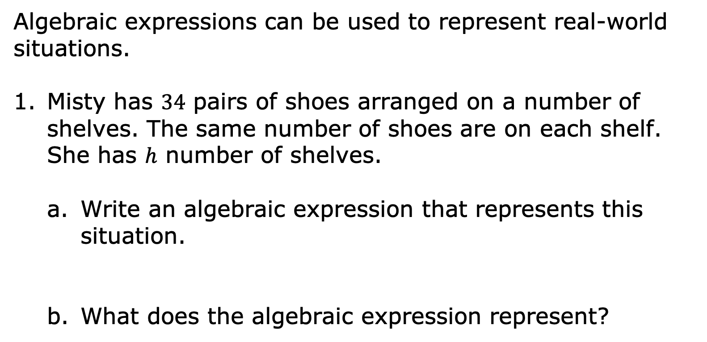
13.5.4 Guided Instruction: Writing Algebraic Expressions from Descriptions of Real-World Contexts
Algebraic expressions can be used to represent real-world situations.
Misty has $34$ pairs of shoes arranged on a number of shelves. The same number of shoes are on each shelf. She has $h$ number of shelves.
Write an algebraic expression that represents this situation.
What does the algebraic expression represent?
volume 2, pg. 289

Slide 25
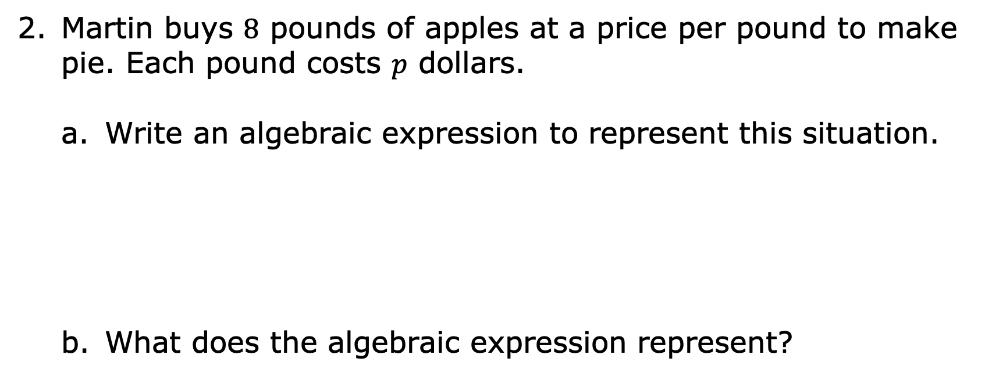
Martin buys $8$ pounds of apples at a price per pound to make pie. Each pound costs $p$ dollars.
Write an algebraic expression to represent this situation.
What does the algebraic expression represent?
volume 2, pg. 289

Slide 26
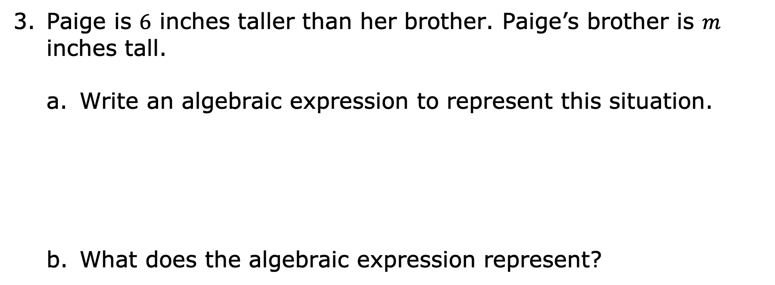
Paige is $6$ inches taller than her brother. Paige’s brother is $m$ inches tall.
Write an algebraic expression to represent this situation.
What does the algebraic expression represent?
volume 2, pg. 289

Slide 27

Try It
volume 2, pg. 290

Slide 28

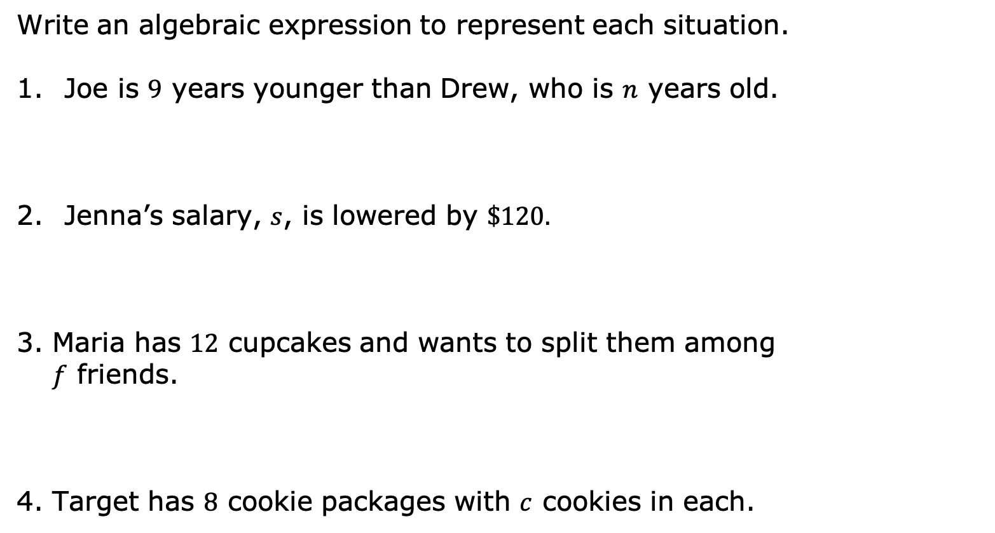
13.5.5 Try It: Writing Algebraic Expressions
Write an algebraic expression to represent each situation.
Joe is $9$ years younger than Drew, who is $n$ years old.
Jenna’s salary, $s$, is lowered by $\$120.$
Maria has $12$ cupcakes and wants to split them among $f$ friends.
Target has $8$ cookie packages with $c$ cookies in each.
volume 2, pg. 290

Slide 29

Wrap-Up
volume 2, pg. 290

Slide 30
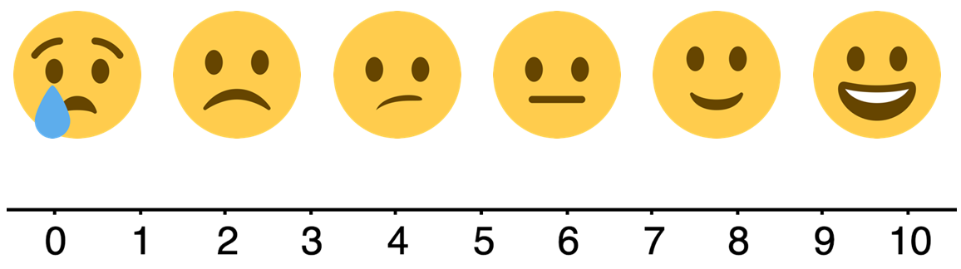
13.5.6 Wrap-Up: Reflection
Choose the emoji that reflects your understanding of translating a written description into an algebraic expression.
Complete the statement.
I chose this emoji because ______
volume 2, pg. 290

